Slide 1
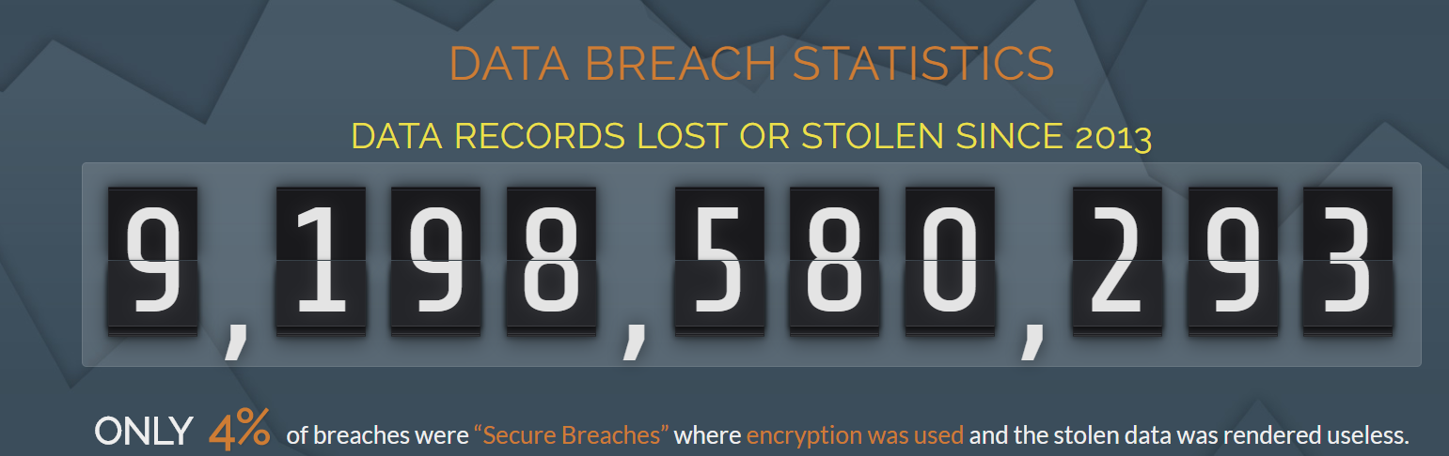
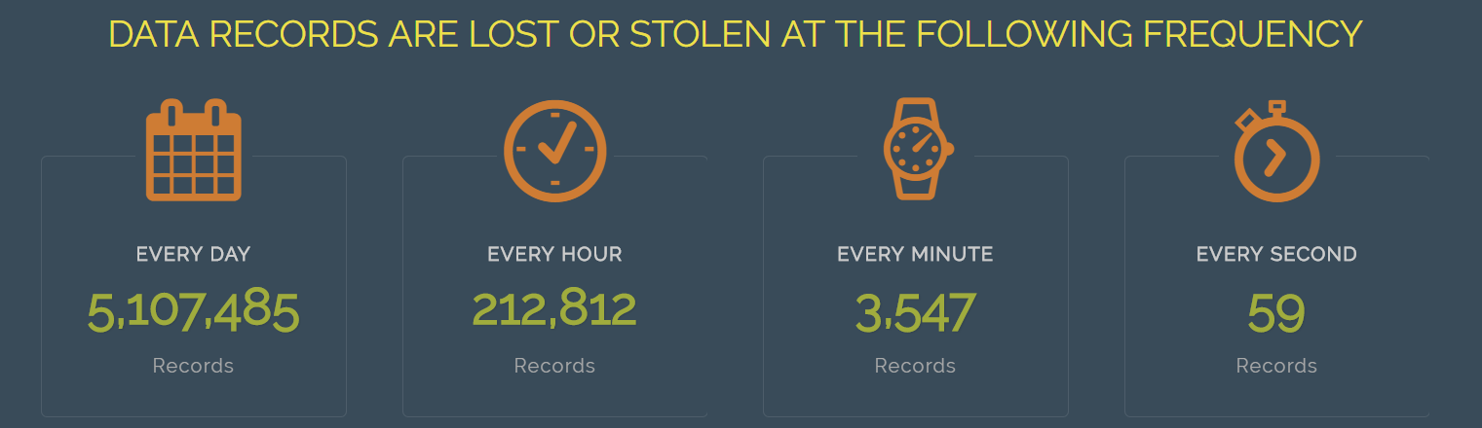
Consumer Complaints
Is Data Privacy at threat with increasing digitization?
Statistic shows 3,547 data stolen every minute.
Research question: How well data privacy is protected in financial sector?
Source: http://breachlevelindex.com/

Slide 2
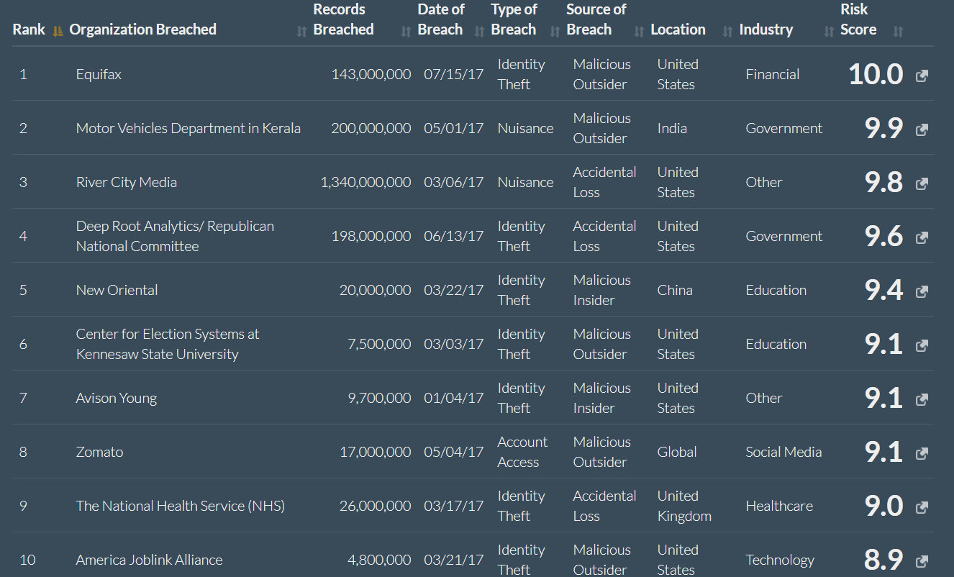
Data Breach across world

Slide 3
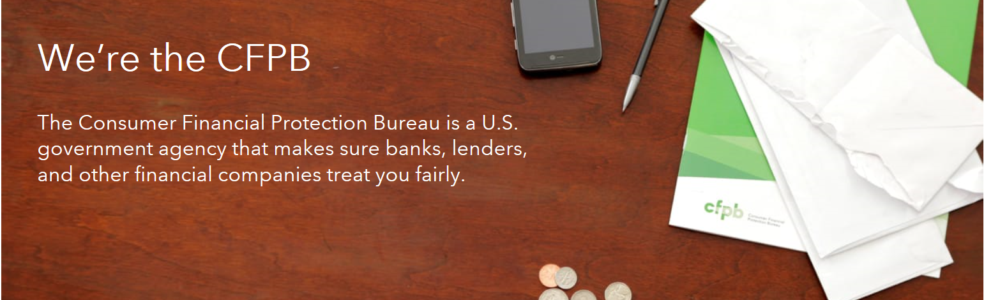
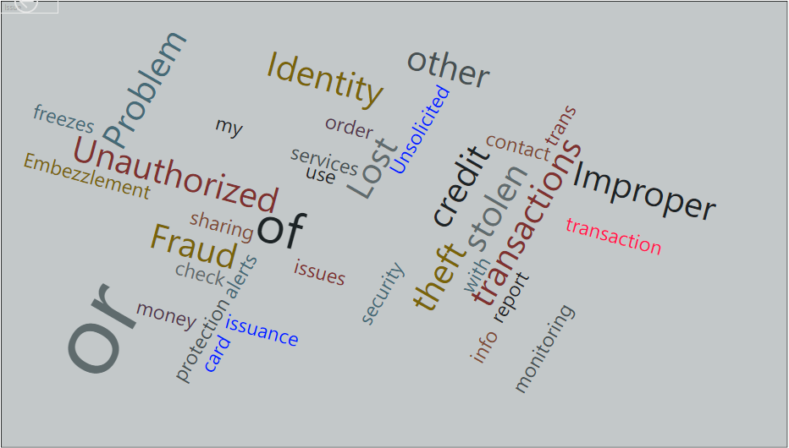
Consumer Complaints
CFBP - Consumer Financial Board Protection data at a glance in resolving consumer complaints
Monetary transactions are equally vulnerable to identity loss and data breach
Word cloud with ‘Unauthorized, theft, stolen, Identity, Improper, Fraud’ etc.,

Slide 4
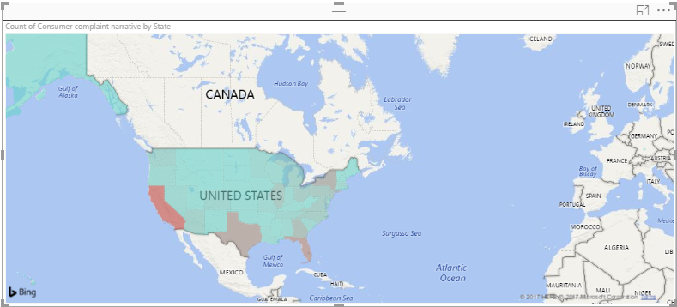
Top Consumer Complaints by state
CA : 129,708
TX : 72,948
FL : 86,839
NY : 61,713

Slide 5
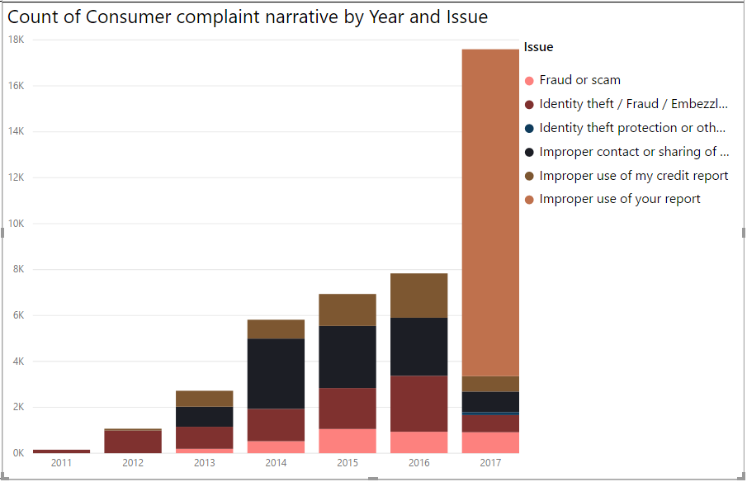
Reasons contributing to Information Loss
Equifax hack

Slide 6
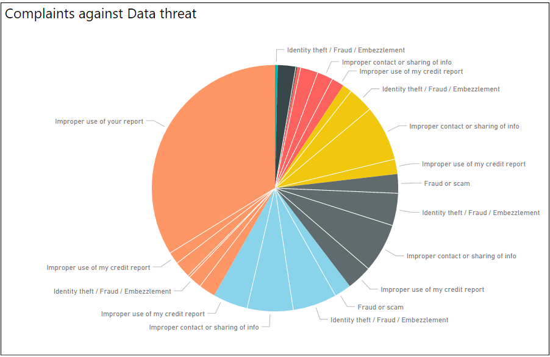
Various Issues Reported
Financial industry is vulnerable
Increased Misuse of data
False marketing
Identity theft

Slide 7
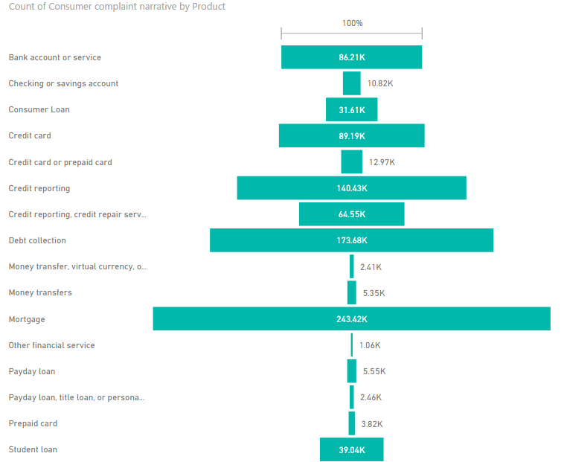
Complaints by Product
Mortgage
Debt Collection
Credit Reporting
Credit Card
Bank account or service

Slide 8
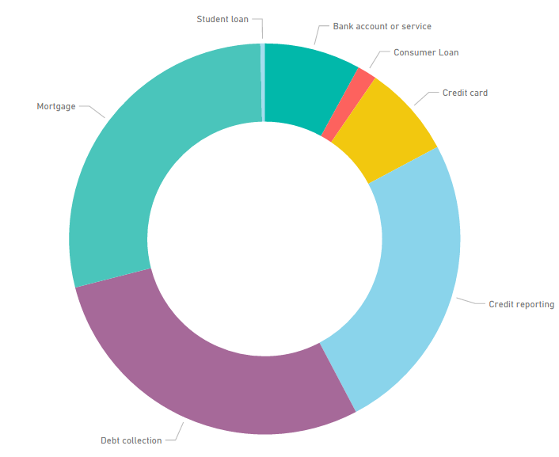
Timely Timely Response
Count of Timely Response
Consumer Loan - 1.61%
Credit card - 7.64%
Bank account/Service - 7.96%
Credit Reporting - 25.07%
Debt Collection - 28.72%
Mortgage - 28.64%

Slide 9
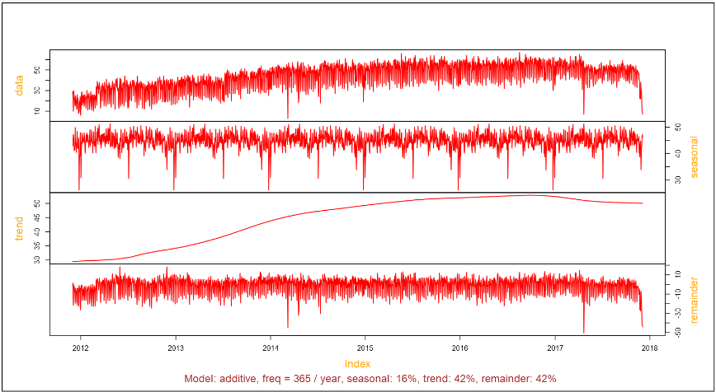
Time Series Decomposition
1.Increasing Trend with Consumer Complaints
2. Seasonal pattern seen in dip every six months

Slide 10
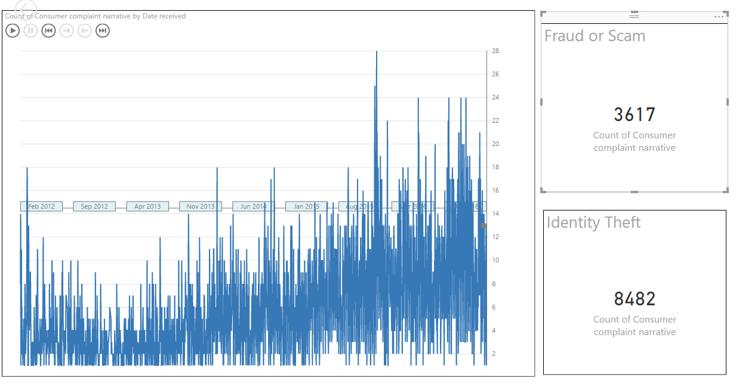
Complaints Pulse
A pulse chart representation of consumer complaints related to Fraud or Scam and Identity Theft.
Clear portrayal of increasing incidents from Jan 2012 to Dec 2016.
Next slide shows a video representation of the same.

Slide 11
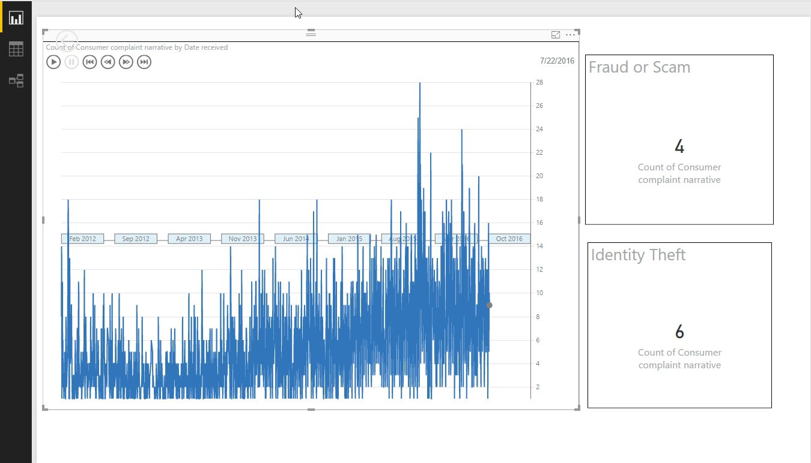
Pulse Chart Video (hit play button below)

Slide 12
Conclusion
Data loss is in increasing trend in Financial sector
Compromise in Privacy is alarming with Identity theft, fraud and scam
Needs multi factor protection and Encryption
Public needs more awareness on possible data breach
Companies needs to tighten security in data collection, storage and delivery
Personal space cannot be lost in the name of digitalization
References Cited: http://http://breachlevelindex.com
Data source: https://catalog.data.gov/dataset/consumer-complaint-database

